Slide 1
Introduction To Programming
By Jayesh Karvir

Slide 2
Hello! I am Jayesh
Work Experience
I am a Software Developer at Wissen Technology. I work on Spring boot and Angular projects for past 1 year.
Highest Qualification
I have done my BTECH in I.T. from KJ Somaiya College of Engineering.

Slide 3
And you are?
I would like to know more about you..

Slide 4
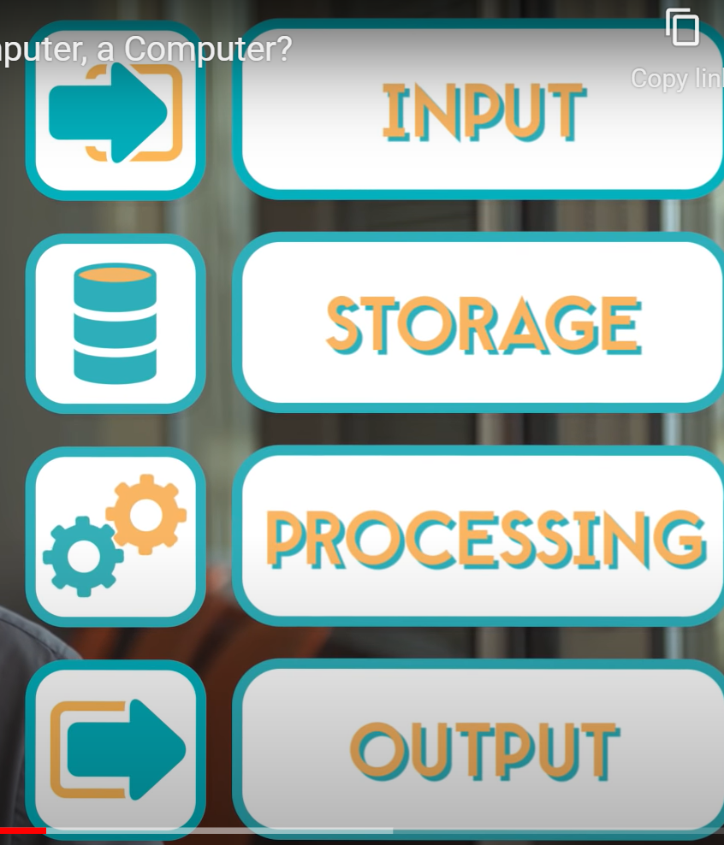
Computers and their impact
Story of Alan Turing
A computer is a programmable electronic device that accepts raw data as input and processes it with a set of instructions (a program) to produce the result as output.
Bits - Smallest unit of information
Binary data
Operating System
Computers are useful but only thing that makes it smart is you!

Slide 5
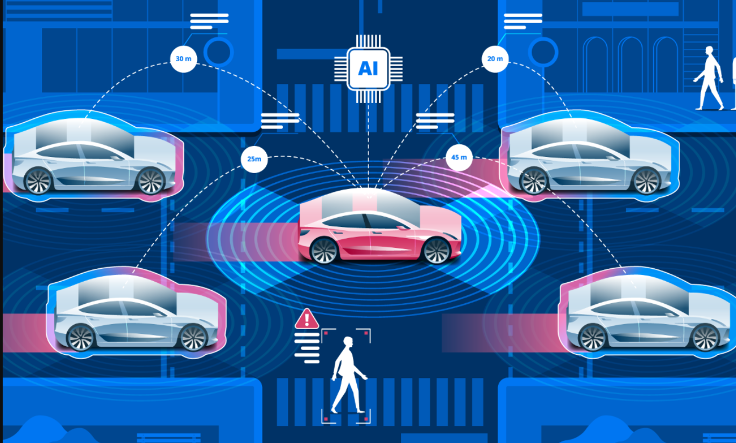
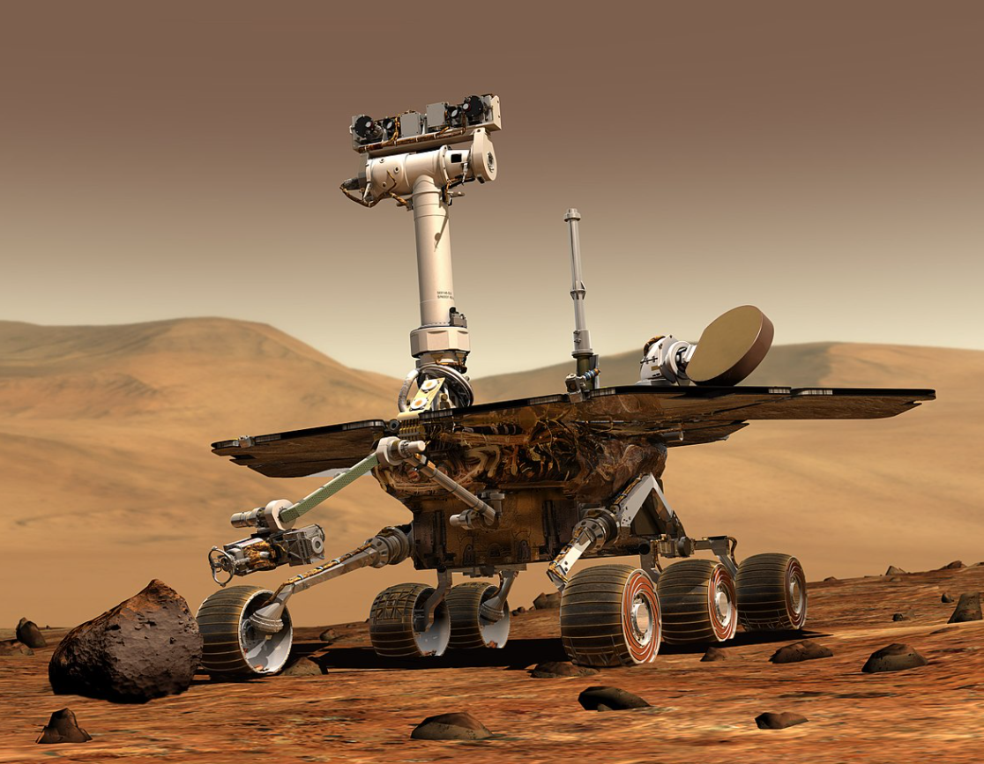
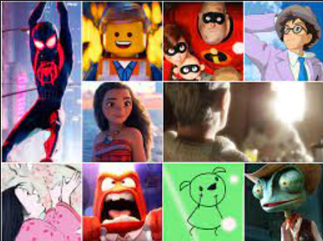
What is programming?
Programming is the process of creating a set of instructions that tell a computer how to perform a task. Acts like a translator between us and the computer.

Slide 6
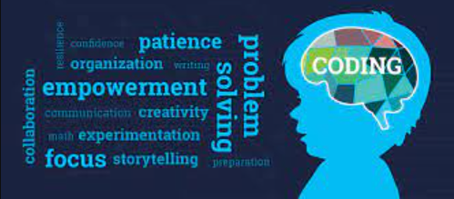
Why should you become a programmer?
Solve real life problems.
High paying job.
Work in any field of your choice.

Slide 7
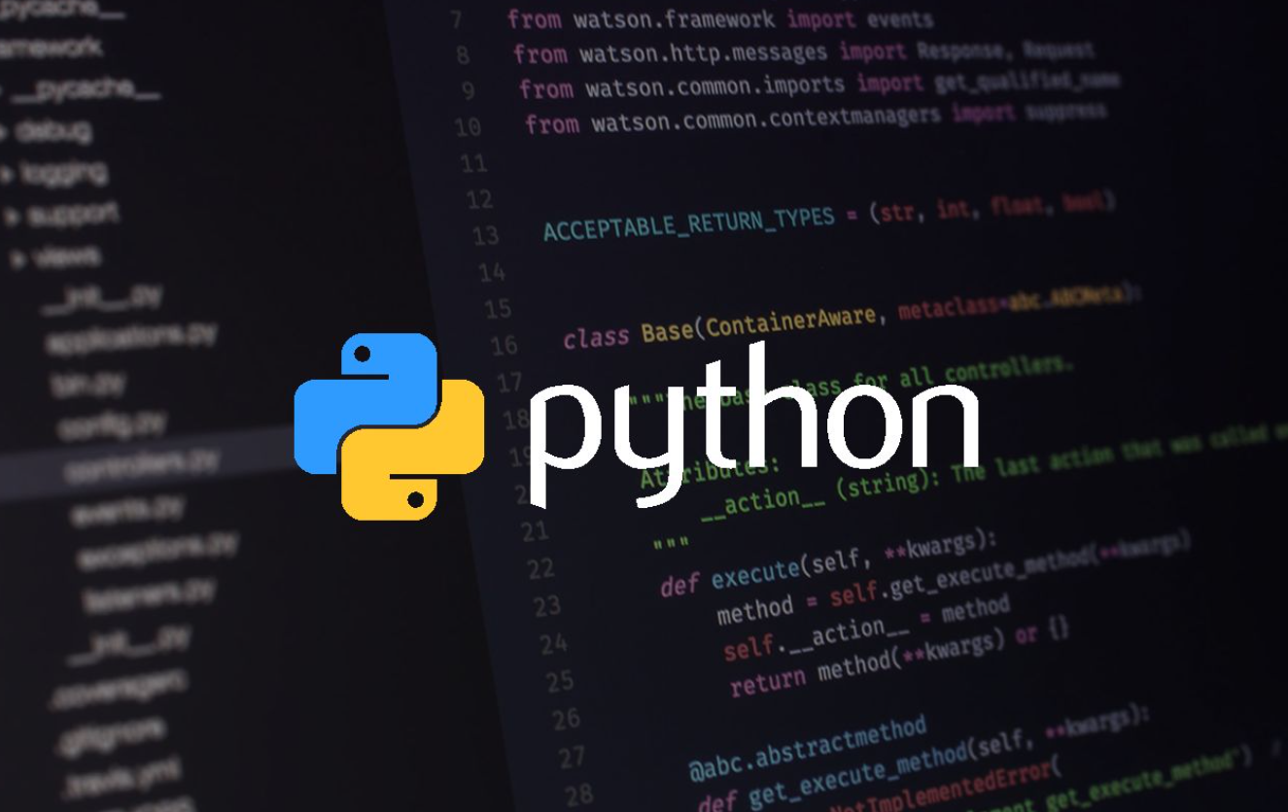
Why Python?
Easy to learn
Modern Programming Language
Mobile apps, websites, games

Slide 8
Definitions
Program :- set of instructions ( Ingredients for baking a cake )
Programming : - The process of doing any work ( Process of baking the cake )
High level language :- humans can easily understand but computers cannot
Low level language :- machine language which is made of 1 or 0 ,humans cannot understand low level language but computers can easily understand

Slide 9
Definitions
Syntax :- Syntax is just like python grammar. It is a set of rules that tells how to write code. Example
Suppose you have written (Python awesome) in English , do you think that it is grammatically correct? This sentence is grammatically wrong (python is awesome ) this sentence is correct, just as in English, there are certain rules of grammar similarly to write some python code some syntax rule are there ,like while writing code if we forget to put any symbol, Colón(:) or parenthesis () etc, then it will display a message of syntax error.

Slide 10
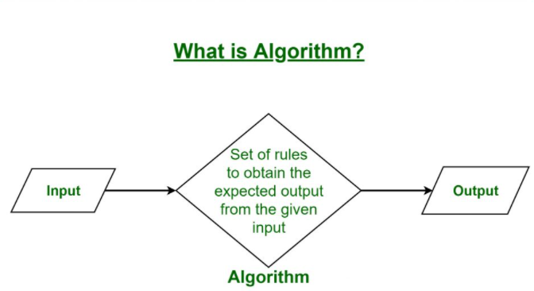
Definitions
Algorithm :- Algorithm is a step by step process to solve any problem. With the help of this we break the problem into smaller parts and then solve it. It can also be defined as a procedure or formula to solve any problem or task.
For e.g. Baking a cake. ( Recipe )

Slide 11
Thank You!

Slide 12
References
Life of Alan Turing
How computers work?
Binary and Data
Circuits
CPU, Memory, Input and Output
Definitions

